Slide 1
Google Cloud Data flow
A solution to processing streaming data
Notes:
My topic today is Google Cloud dataflow, which is a service offered by Google for processing batch as well as stream data but this presentation focuses on stream data

Slide 2
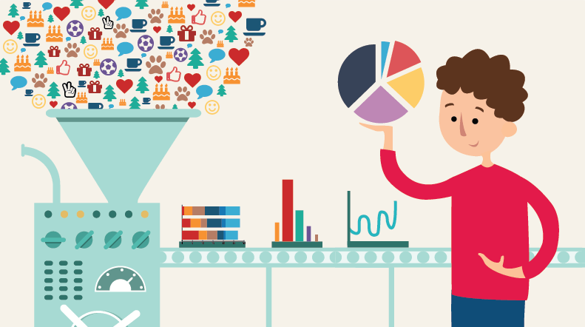
What is streaming data?
Also known as real-time data
Sensor data, data from social networks, stock market data
Generated continuously from thousands of sources
Cannot be stored due to large volume
Notes:
Think of all the social networking sites that you use, there are millions of people tweeting or updating their status or posting a picture every second. Data gets generated continuously like a stream of running water. Data from weather or tidal sensors , where the measurements are continuously recorded is another example of streaming data.
This data is difficult to process because it is being updated continuously and larger volumes of data cannot be stored without significant costs. As a result, it needs to be processed as it is generated. But how is processed?

Slide 3
How do you process streaming data?
Large scale data processing and analysis today is mainly focused on working with static datasets (batch processing)
Information is stored for a while before being processed
Hadoop, the most popular big data processing framework is also more suited to static data
Notes:
Conventionally, data processing has always been an activity that uses data that is accessed from storage. Huge amounts of data are loaded from the datastore and input into the program and usually processed in batches. Even Hadoop, cannot process streaming data.

Slide 4
Well, then how DO you?
Google cloud dataflow is the solution
Specifically designed to make stream data processing easier
User focuses on logical implementation
Physical implementation by cloud dataflow runner services
Notes:
This is where google cloud dataflow comes into the picture. It is a relatively new service offered by google that can deal stream processing in the cloud. It is designed such that low level activities like performance, scaling, availability, security and compliance handled automatically by cloud dataflow runner services so that the user is only responsible for implementation of the code or algorithms.

Slide 5
Components
Pipeline: group of computations where data is input, processed and output.
Pcollection: used to represent data in the pipeline. Bounded and unbounded
Transform: Data processing operations in the pipeline.
I/O source and sink- source and output data
Notes:
Conceptually, The whole model has 4 parts. It is referred to as a pipeline. The input and output can be of the same type or of different types.
Data in the pipeline is represented in the form of Pcollections. These classes act as containers to represent data that can be bounded or unbounded. Thus this model can be used for batch as well as stream processing.
A transform is any data processing operation it takes a Pcollection as an input, performs an operation and produces an output Pcollection.
The I/O source and sink allow the pipeline to source and output data in multiple storages and formats.

Slide 6
Conceptual Layout
Notes:
Data from multiple sources goes into the input sink. This isn’t a place to store data but all the data needs to be combined before it can be processed.
After this, the data is read into the system which is where it gets converted to a Pcollection.
Data processing operations are performed on Pcollections and the results are written to the output sink which could be a database or a data warehouse.

Slide 7
Advantages
Multifunctional- ETL, batch processing and streaming real-time analytics amongst its capabilities.
Well connected- Seamless integration with other google technologies (cloud pub/sub, bigquery, cloud machine learning)
Faster- significantly faster than Hadoop for larger data(petabytes)
Notes:
Most Big data processing services focus on one aspect, it could be batch processing like Hadoop or super fast analytics like spark but cloud dataflow boasts of ETL, batch processing as well as stream processing.
It can be used in conjunction with all other offerings by google like cloud pub/sub which is used for stream data ingestion, bigquery which is used for warehousing and cloud machine learning which is googles ML service for the cloud.
Dataflow also has an advantage over Hadoop when it comes to batch processing data that is in the order of petabytes

Slide 8
Disadvantages
Bound to Google technologies
Not suited for data scientists experimenting with data
Limited to 1024 cores (spark can use 8000)
Notes:
Integration with google also means that to some extent, dataflow is bound to google technologies, and using external services might become difficult. Added to that, it lacks support for the REPL loop so is better suited for production level jobs and not for experiments with data.
Another issue is that the maximum number of cores that can be used is hard-set to 1024 which is a lot less than spark. This isn’t a huge problem right now because most jobs today need a lot less computing power but could be a problem in the future.

Slide 9
Alternatives
Spark is a open source alternative to dataflow.
Better for experimental data processing
Apache Beam is a possible mediator
Notes:
Spark is a good open source alternative for when you want to experiment with data.
But then, if you’re unsure of what processing engine to use, Apache beam is a good compromise,
Using this, one could write their code and then decide which engine to use as this is compatible with different engines like Dataflow, Spark and Flink.

